Slide 1
Normalisation
Week 2 – Part 2

Slide 2
Learning objectives
What is normalisation?
Why do we need normalisation?
Types of dependencies – functional and transitive
Various levels of normalization and examples

Slide 3
What is normalisation?
Database normalization, or just normalization is:
A process used for data modelling or database creation, where you organize your data and tables so it can be added and updated efficiently.
Done manually at design time (no ‘click a button and do it’!)

Slide 4
What is normalisation?
Introduced alongside the relational model in the early 70’s by Codd, et al.
Many different normal forms: UNF, 1NF, 2NF, 3NF, BCNF (Boyce-Codd Normal Form) , 4NF, ETNF, 5NF, DKNF, 6NF.
Subtle differences between each.
Goals:
Independence of data tables
Each Normalization Form (1NF, 2NF, 3NF) has increasing levels of independence
This module looks at 1NF, 2NF, 3NF normalisations

Slide 5
Why do we need normalisation?
Make the database more efficient
Prevent duplicates - the same data from being stored in more than one place
Ensure consistency and relevance - prevent updates being made to some data but not others
Prevent data not being deleted when it is supposed to be, or from data being lost when it is not supposed to be
Ensure data accuracy
Reduce the storage space that a database takes up
Optimise query execution times - Ensure the queries on a database run as fast as possible
Without normalization, running the database can be slow and is almost guaranteed to be hard to manage, update and keep accurate

Slide 6
Non-normalised Table Example
A student database
You want to keep track of:
The student name
Program (Degree) Name
Classes(s) taken
Fees paid
Student ID | Student Name | Fees Paid | Program Name | Class 1 | Class 2 | Class 3
1 | John Smith | 200 | Economics | Economics 1 | Biology 1
2 | Maria Griffin | 500 | Computer Science | Biology 1 | Business Intro | Programming 2
3 | Susan Johnson | 400 | Medicine | Biology 2
4 | Matt Long | 850 | Dentistry

Slide 7
Non-normalised Table Example (Cont.)
This creates some immediate problems
Student ID | Student Name | Fees Paid | Program Name | Class 1 | Class 2 | Class 3
1 | John Smith | 200 | Economics | Economics 1 | Biology 1
2 | Maria Griffin | 500 | Computer Science | Biology 1 | Business Intro | Programming 2
3 | Susan Johnson | 400 | Medicine | Biology 2
4 | Matt Long | 850 | Dentistry
Can you spot them?

Slide 8
Non-normalised Table Example (Cont.)
What happens when you want to add a new student, but their program is not known?
Student ID | Student Name | Fees Paid | Program Name | Class 1 | Class 2 | Class 3
….
5 | Jim Kirk | 0 | ?
You are adding incomplete data – which can cause problems when analyzing the data
This is an ‘INSERT’ anomaly.
You can’t add a student without also adding their classes

Slide 9
Other Anomalies – Modifying Data
Rename Biology 1 to “Intro to Biology”
Student ID | Student Name | Fees Paid | Program Name | Class 1 | Class 2 | Class 3
1 | John Smith | 200 | Economics | Economics 1 | Biology 1
2 | Maria Griffin | 500 | Computer Science | Biology 1 | Business Intro | Programming 2
3 | Susan Johnson | 400 | Medicine | Biology 2
4 | Matt Long | 850 | Dentistry
We would have to search and locate EVERY instance of Biology 1 and make sure we update it
This would be an ‘UPDATE’ anomaly. You can make a change, but fail to make ALL the necessary changes
More effective better if we could only make ONE change, and cover everyone taking Biology

Slide 10
Other Anomalies – Removing Data
Susan Johnson drops out, and we delete the record …
Student ID | Student Name | Fees Paid | Program Name | Class 1 | Class 2 | Class 3
1 | John Smith | 200 | Economics | Economics 1 | Biology 1
2 | Maria Griffin | 500 | Computer Science | Biology 1 | Business Intro | Programming 2
3 | Susan Johnson | 400 | Medicine | Biology 2
4 | Matt Long | 850 | Dentistry
Student ID | Student Name | Fees Paid | Program Name | Class 1 | Class 2 | Class 3
1 | John Smith | 200 | Economics | Economics 1 | Biology 1
2 | Maria Griffin | 500 | Computer Science | Biology 1 | Business Intro | Programming 2
4 | Matt Long | 850 | Dentistry
This would remove ALL traces of Biology 2
This would be a ‘DELETE’ anomaly. Deleting one thing results in other data (that you want to keep) being deleted
Notes:
You would want to delete the student record, but not wipe out the existence of the Class!!

Slide 11
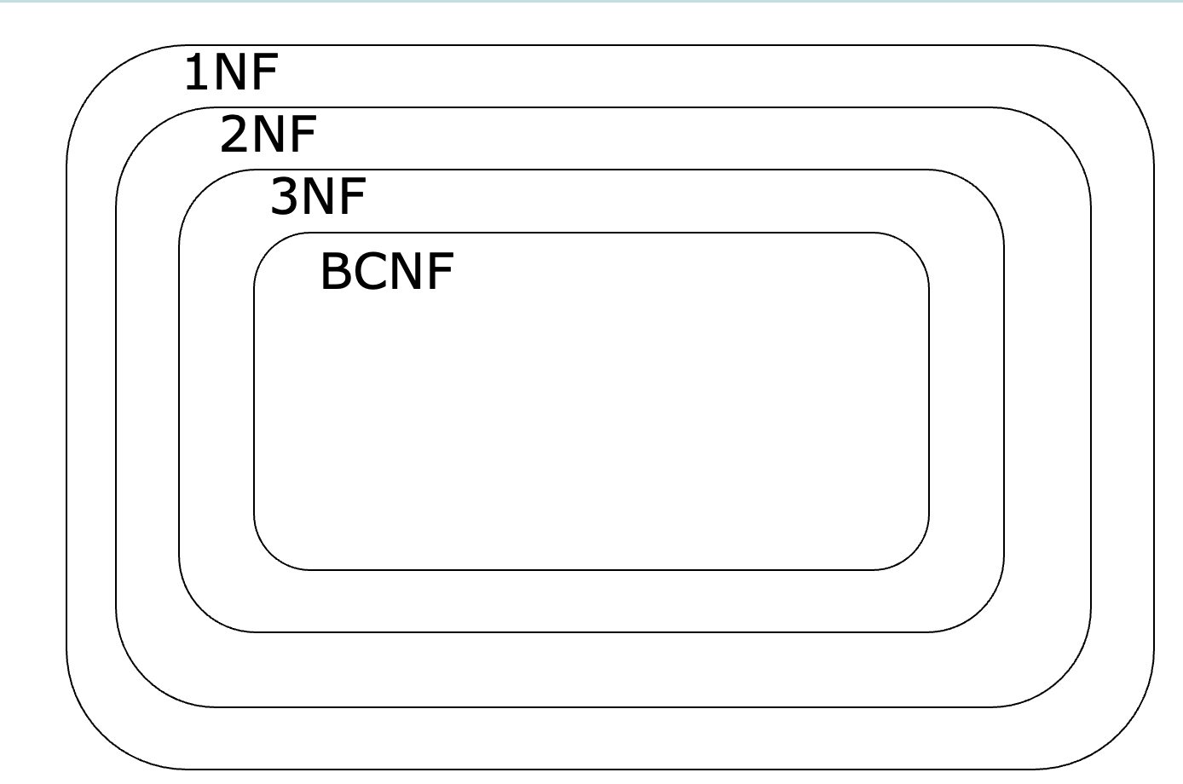
Normalisation Levels
Notes:
There are also 4NF (fourth normal form) and 5NF (fifth normal form). There’s even 6NF (sixth normal form), but the most common normal form you’ll see out there is 3NF (third normal form).

Slide 12
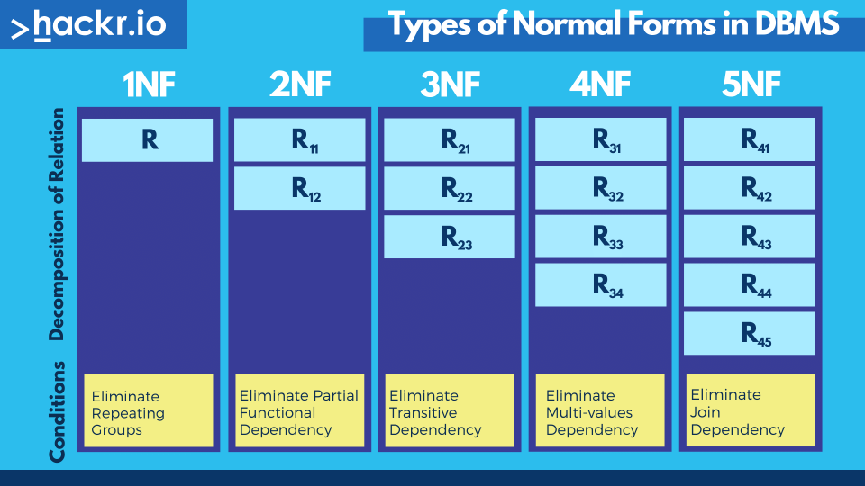
Image from https://hackr.io/blog/dbms-normalization

Slide 13
First Normal Form - 1NF
For a table to be in the 1NF, it must meet the following criteria
A single cell must not hold more than one value (atomicity)
There must be a primary key for identification
No duplicated rows or columns
Each column must have only one value for each row in the table

Slide 14
1 NF Example
Student Name | Fees Paid | Date of Birth | Program Name | Class 1 | Class 2 | Class 3 | Class 4 | Teacher Name
John Smith | 1800 | 04-Aug-91 | Economics | Economics 1 (Business) | Biology 1 (Science) |  |  | James Peterson
Maria Griffin | 1500 | 10-Sep-92 | Computer Science | Biology 1 (Science) | Business Intro (Business) | Programming 2 (IT) |  | James Peterson
Susan Johnson | 2000 | 13-Jan-91 | Medicine | Biology 2 (Science) |  |  |  | Sarah Francis
Matt Long | 1400 | 25-Apr-92 | Dentistry |  |  |  |  | Shane Cobson
Does the combination of all columns make a unique row every single time?
No. You could have people with the same name, classes etc. – might be rare, but could happen
What field can be used to uniquely identify the row?
Is this the student name? No. Class? No, this isn’t unique either. So we would need a Primary Key!

Slide 15
What can we do?
Use ID as primary key
PK | ID
 | Name
 | Fees Paid
 | DoB
 | Program Name
 | Class 1
 | Class 2
 | Class 3
 | Class 4
 | Teacher Name
1NF Schema
Primary Key

Slide 16
Questions

Slide 17
Image from https://hackr.io/blog/dbms-normalization

Slide 18
Second Normal Form – 2 NF
The rule of second normal form on a database can be described as:
Fulfil the requirements of first normal form
Each non-key attribute must be functionally dependent on the primary key

Slide 19
Functional Dependency
Functional dependency is a concept that specifies the relationship between two sets of attributes where one attribute determines the value of another attribute.
It is denoted as X → Y, where the attribute set on the left side of the arrow
X is called Determinant, Y is called the Dependent

Slide 20
Functional Dependency Example
Student ID | Student Name | Fees Paid | Program Name | Class 1 | Class 2 | Class 3
1 | John Smith | 200 | Economics | Economics 1 | Biology 1
2 | Maria Griffin | 500 | Computer Science | Biology 1 | Business Intro | Programming 2
3 | Susan Johnson | 400 | Medicine | Biology 2
4 | Matt Long | 850 | Dentistry
The primary key is student ID, which represents the student. Let’s look at each column:
Student Name
Fees Paid
Program Name
Class 1
Class 2
Class 3
Yes, this is dependent on the primary key. A different student ID means a different student name.
Yes, this is dependent on the primary key. Each fees paid value is for a single student.
No, the program name is not dependent on the student.
No, this column is not dependent on the student. More than one student can be enrolled in one class. If the class is removed, the student stays etc.
As above, more than one class is allowed.
Notes:
As students for ideas on dependencies

Slide 21
2 NF Example
class ID | class name
1 | Economics 1 (Business)
2 | Biology 1 (Science)
3 | Business Intro (Business)
4 | Programming 2 (IT)
5 | Biology 2 (Science)
student ID | student name | fees paid | date of birth
1 | John Smith | 200 | 04-Aug-91
2 | Maria Griffin | 400 | 10-Sep-92
3 | Susan Johnson | 800 | 13-Jan-91
4 | Matt Long | 600 | 25-Apr-92
teacher ID | teacher name
1 | James Peterson
2 | Sarah Francis
3 | Shane Cobson
program ID | program name
1 | Computer Science
2 | Dentistry
3 | Economics
4 | Medicine
But how do we connect all the data?

Slide 22
Foreign Keys
class ID | class name
1 | Economics 1 (Business)
2 | Biology 1 (Science)
3 | Business Intro (Business)
4 | Programming 2 (IT)
5 | Biology 2 (Science)
Foreign key
student ID | program ID | student name | fees paid | date of birth
1 | 3 | John Smith | 200 | 04-Aug-91
2 | 1 | Maria Griffin | 400 | 10-Sep-92
3 | 4 | Susan Johnson | 800 | 13-Jan-91
4 | 2 | Matt Long | 600 | 25-Apr-92
teacher ID | teacher name
1 | James Peterson
2 | Sarah Francis
3 | Shane Cobson
program ID | program name
1 | Computer Science
2 | Dentistry
3 | Economics
4 | Medicine

Slide 23
How to manage the other tables?
Questions:
How are teachers related to others?
A student can have one teacher for all classes
A subject could have a single teacher that teaches that specific class
Program could have a teacher that teaches all classes for the program
Multiple teachers could teach a particular class
Does a teacher have many classes?
Does a class have many teachers?
Many to many relationship
Yes
Possibly, yes but also some classes have only 1.

Slide 24
Questions

Slide 25
Image from https://hackr.io/blog/dbms-normalization

Slide 26
Third Normal Form – 3NF
Third normal form is the final stage of the most common normalization process. The rule for this is:
Fulfils the requirements of 2NF (thus also 1NF)
Has no transitive functional dependency

Slide 27


Transitive Functional Dependency
A
A determines B
B
Every attribute that is not the primary key must depend on the primary key and the primary key only.
B determines C
C
A
B
A determines B
B determines C
B
C

Slide 28
Transitive Functional Dependency Example
Primary key
Student ID | Name | City | Postcode
1 | John Smith | London | LXY1Y
2 | Maria Griffin | Birmingham | B4GXZ
3 | Susan Johnson | Amsterdam | 8FP9K
4 | Matt Long | Vienna | 8901K
Here the primary key is Student ID, but we can identify the City using Postcode, where City and Postcode both are the primary key
So here Student ID→ City and City→Postcode eventually resulting into
Student ID→Postcode
We can find a non-primary attribute using another non-primary attribute.
This type of functional dependency is known as Transitive Dependency

Slide 29
3 NF Example
Bank Code | Bank Name
303 | BoA
400 | Chase
501 | ESL
Cust_ID | Name | Acct_ Number | Bank Code | Bank Name
1 | John Smith | 200004 | 400 | Chase
2 | Maria Griffin | 545151 | 501 | ESL
3 | Susan Johnson | 353453 | 400 | Chase
4 | Matt Long | 784234 | 303 | BoA
Cust_ID | Name | Acct_ Number | Bank Code
1 | John Smith | 200004 | 400
2 | Maria Griffin | 545151 | 501
3 | Susan Johnson | 353453 | 400
4 | Matt Long | 784234 | 303
Bank Name depends on Bank Code

Slide 30
Summary
What is normalisation?
Why do we need normalisation?
Types of dependencies – functional and transitive
Various levels of normalisation and examples – 1NF, 2NF, 3NF

Slide 31
Next Week
Week | Lecture Dates (Edgbaston) | Lab Dates (Edgbaston) | Topic
1 | Group 1 - Wednesdays (10:00-12:00) Group 2 - Fridays (12:00-14:00) | Fridays (14:00-17:00) | Introduction to databases; Database design guidelines
2 |  |  | Database design, Entity relation (ER) modelling; Keys; Normalisation​
3
3 |  |  | Creating and populating databases; PostgreSQL
4 |  |  | SQL Querying – Operators, Ordering, Aggregation; NoSQL and Graph Databases
5 |  |  | NoSQL and Graph Databases; Class Test
6 |  |  | Assessment support week
7 |  |  | Web programming introduction; Tech stack, Template application
8 |  |  | Web applications vs Static pages; Tech stack concepts; REST APIs; RESTFUL style
9 |  |  | SpringBoot application structure,; SpringBoot annotations, case study
10 |  |  | Front end concepts, TypeScript fundamentals, Angular front end development,
11 |  |  | Class Test

Slide 32
Questions?

Slide 33
References
Ramakrishnan, R., Gehrke, J. and Gehrke, J., 2003. Database management systems (Vol. 3). New York: McGraw-Hill.Rochester
University of Cambridge, Lecture 7: Schema Refinement and Normalisation
Examples on database anomalies from Rochester Institute of Technology, 03- Database Normalisation, Available online

